Slide 1
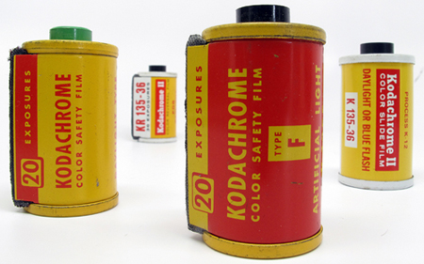
Kodachrome
Kodachrome was introduced in 1935 by the company Eastman Kodak. It is a type of color reversal film.

Slide 2
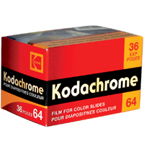
Kodachrome is one of the first successful color materials, it was used for cinematography and stills photography.

Slide 3
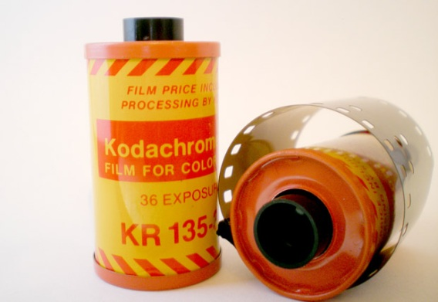
Kodachrome was sold process-paid until 1954 because of its complex processing requirements. At the time there was a legal ruling that prohibited this process.

Slide 4
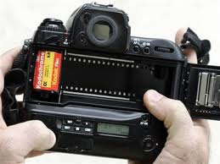
Due to digital photography Kodachrome has become obsolete. They stopped manufacturing it in 2009 and film processing ended in 2010.

Slide 5
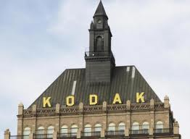
Eastman Kodak Company
Kodachrome was created by the “Eastman Kodak Company. "The company was founded by George Eastman 1889 and is responsible for great innovation's in the photography field.

Slide 6
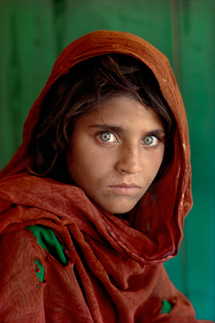
This picture was the cover of National Geographic in December 1984. I think it was the first photograph that really caught my eye artistically, this is just one of the amazing pictures that popped up when I googled kodachrome and pictures. The green in her eyes matching the background is amazing, I think that most people that have seen this photograph can appreciate its beauty.

Slide 7
Kodachrome allowed people to take multiple shots at a faster rate. It revolutionized how easy and fast people could get their shots. I found that a lot of photographers were extremely upset when they stopped producing the film. I think this day and age anybody with a good camera, printer and a little knowledge can get good images. Back then it was a lot more trial and error.

Slide 8
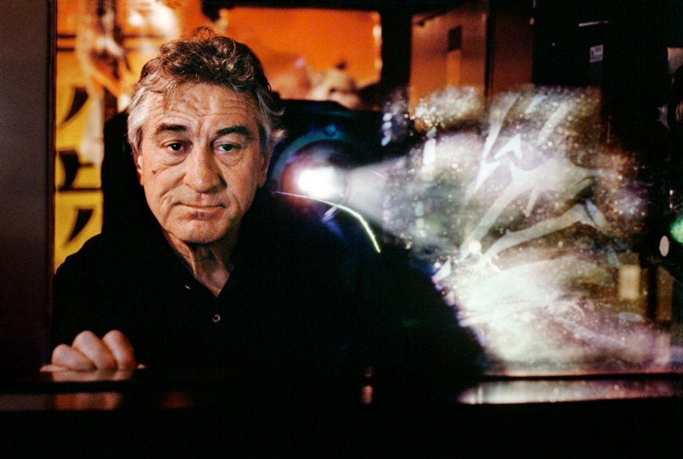
Kodachrome was a standard film for photography and cinematography. It is responsible for a huge chunk of the most important and beautiful images of the nineteenth century.

Slide 9
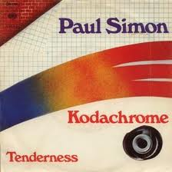
Kodachrome was so popular Paul Simon actually wrote a song about it. It was named “Kodachrome” after the 35mm film. It hit the Billboard top 100 in 1973 and it peaked at number nine.

Slide 10
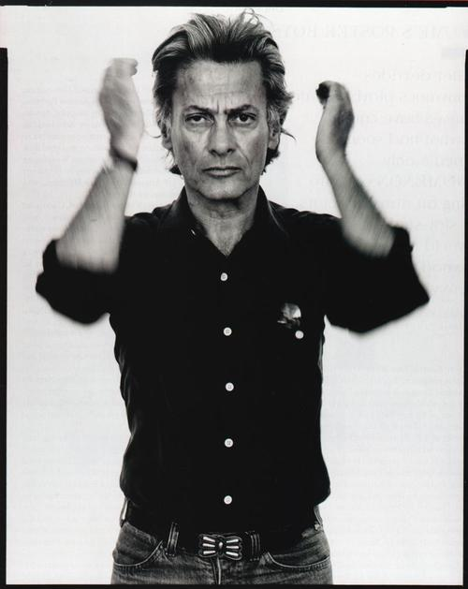
Richard Avedon is one of the photographers that took full advantage of all the things Kodachrome can provide. Being that it was introduced just fifteen years before his job at Bazaar, I am sure he used that film a lot.

Slide 11
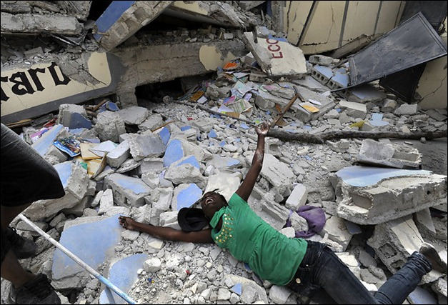
Another example of a great artist that used this film to the best of their ability was Pulitzer Prize winner Carol Guzy. She was born in 1956 and over the years of brought us face to face with some of the biggest tragedies of our time.

