Slide 1
Media 175 Principles of Digital Photography
Photographer: Keegan Gibbs
Presented by Luke Kisena

Slide 2
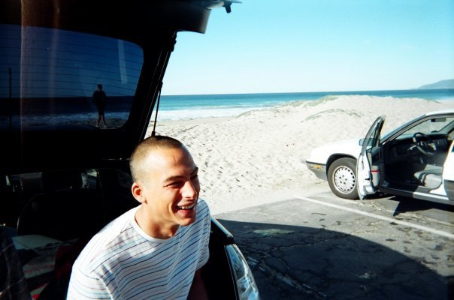
Keegan Gibbs 1984-Present
“The fear and adrenaline of getting caught, quickly replaced any fear
of heights I had”.
Keegan Gibbs

Slide 3
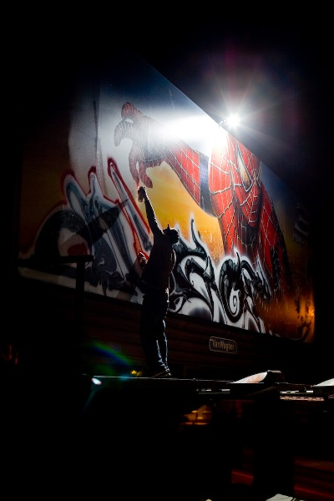
Keegan Gibbs shoots the elements and individuals that make up my life. This website is sort of a culmination of those moments, coupled with work I have shot along the way. .
Photo by Keegan Gibbs

Slide 4
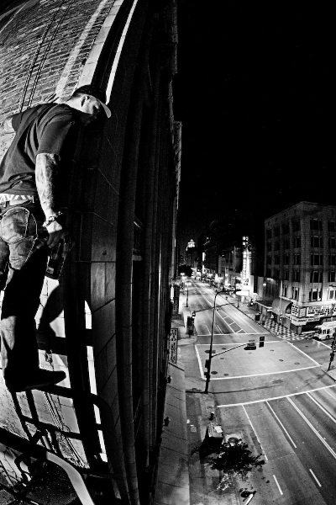
Keegan Gibbs is a photographer that is willing to risk his freedom and his rights for the sake of photography and art. He likes to stick to black and white photos and loves the grainy and vintage look.
Photo by Keegan Gibbs

Slide 5
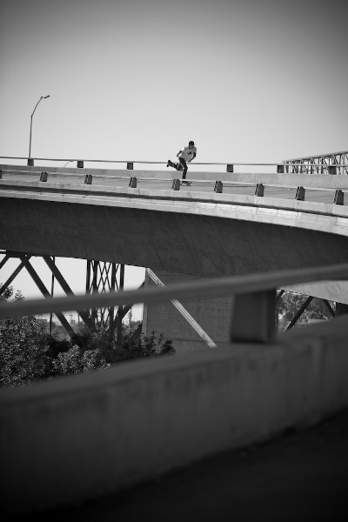
Photo by Keegan Gibbs

Slide 6
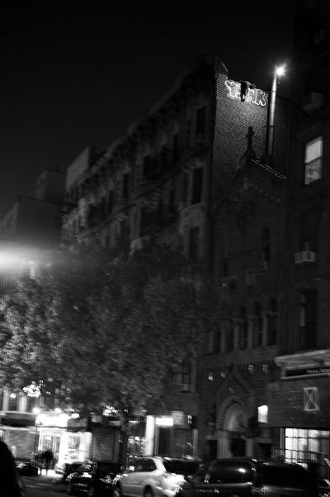
Photo by Keegan Gibbs

Slide 7
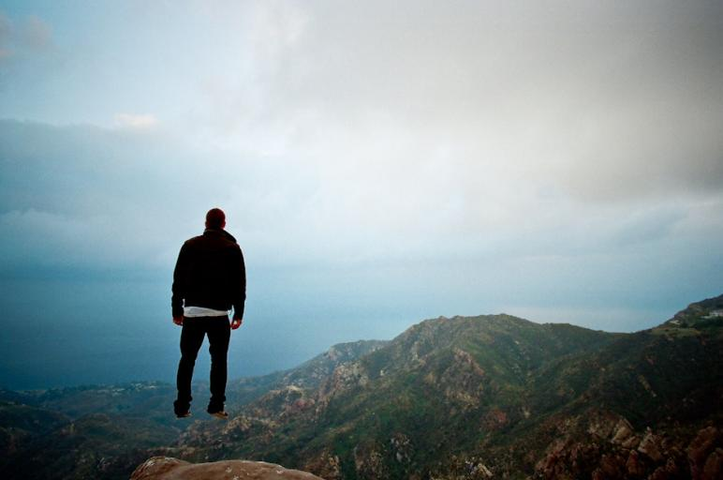
Photo by Keegan Gibbs

Slide 8
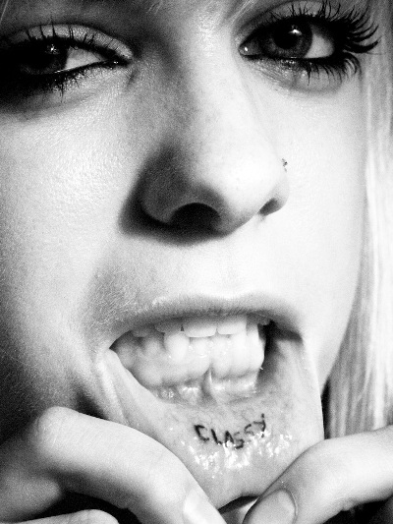
Photo by Keegan Gibbs

Slide 9
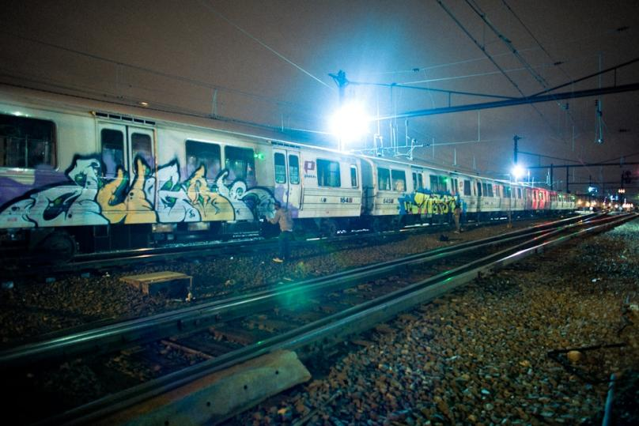
Photo by Keegan Gibbs

Slide 10
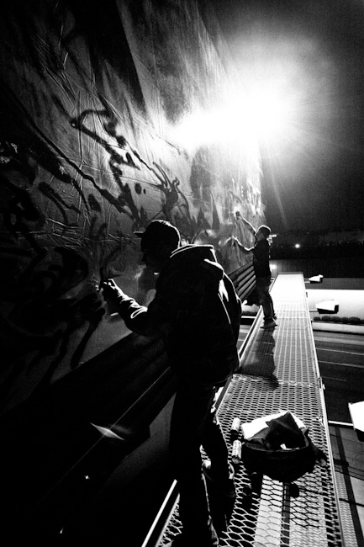
Photo by Keegan Gibbs

Slide 11
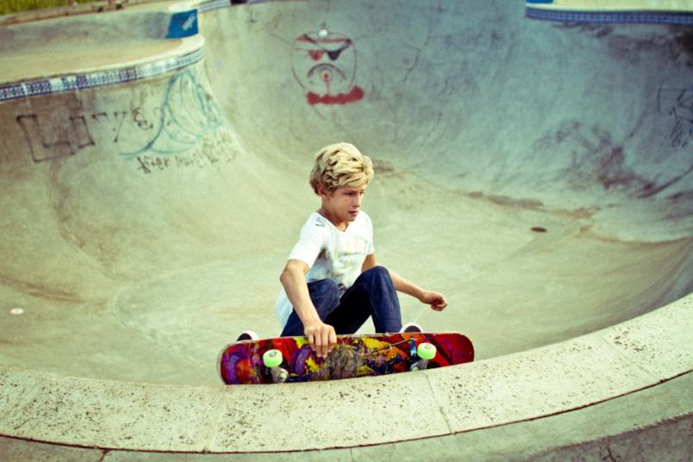
Photo by Keegan Gibbs

Slide 12
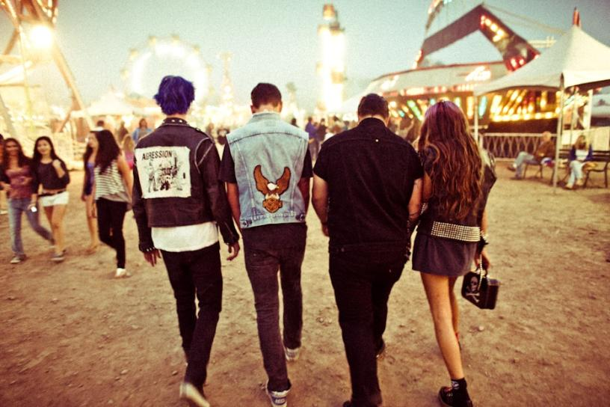
Photo by Keegan Gibbs

